Slide 1
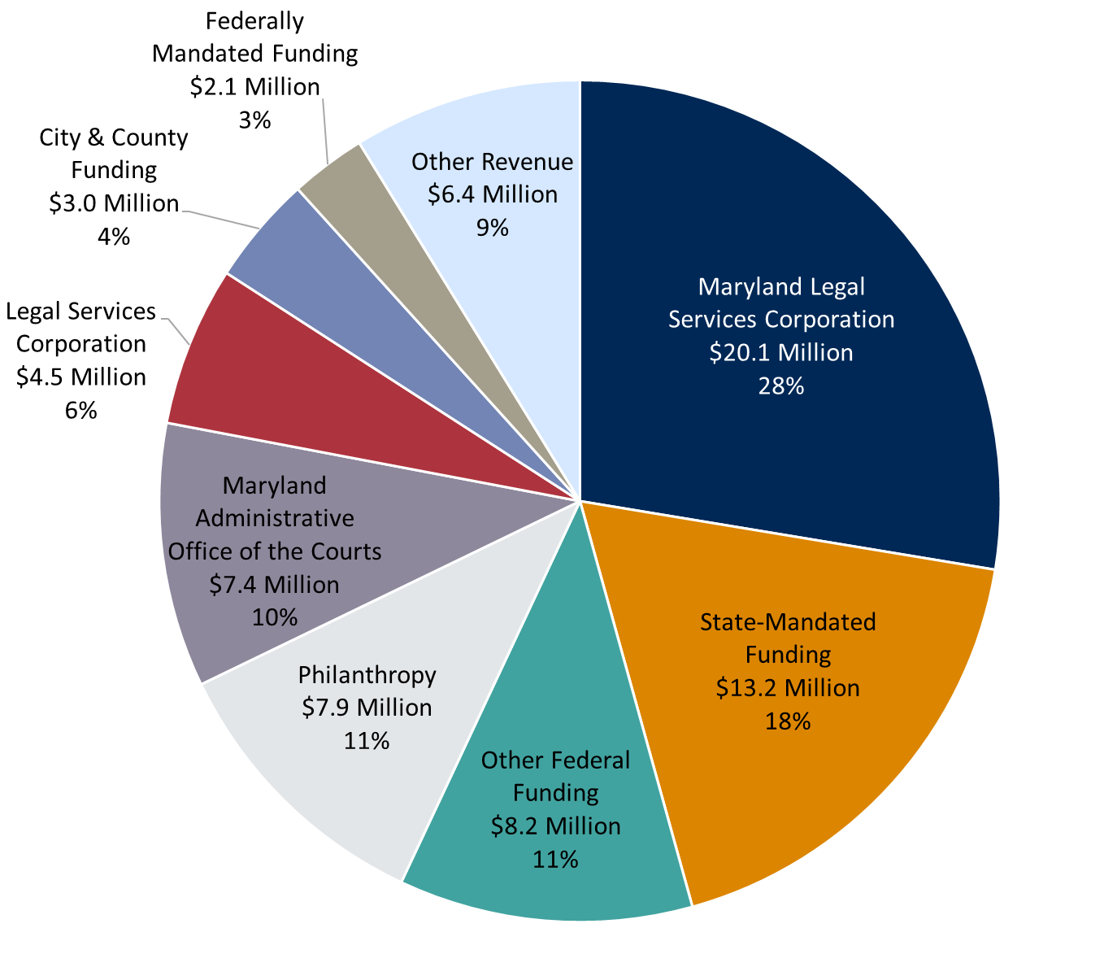
Funding for Civil Legal Aid in Maryland
Fiscal Year 2019: $72.9 Million
As Reported by MLSC Grantees
Notes:
State-Mandated includes CINA, Guardianship, Mental Health/ Developmental Disabilities and Court-Appointed Attorney Program
Federally Mandated includes Protection & Advocacy (people with disabilities) and Title III (seniors)
Other Revenue includes general funds from multi-service organizations, other state funding, client fees, attorney fees, interest, cy pres and publications

Slide 2
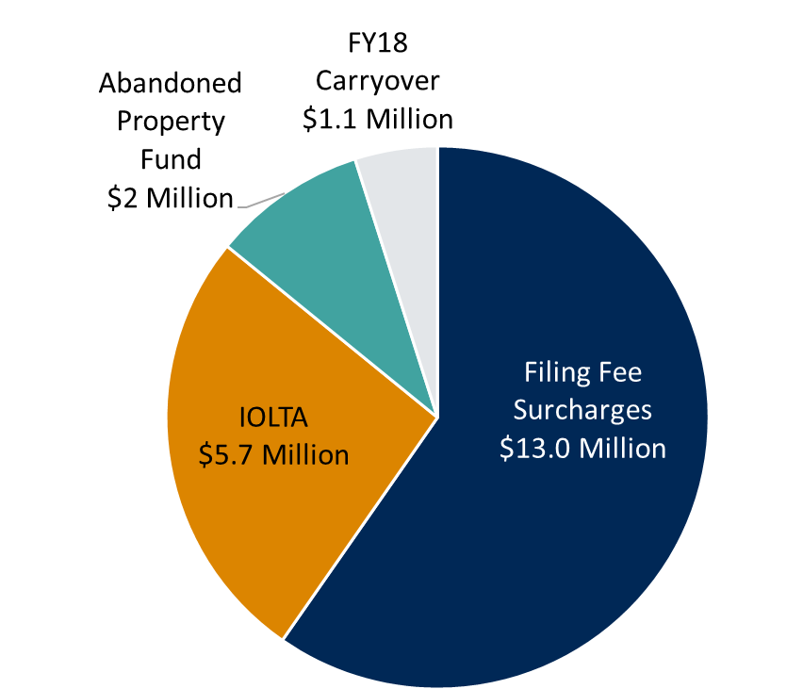
MLSC Fund Revenue
Fiscal Year 2019: $21.7 Million
Notes:
The MLSC Fund Appropriation is set in the State’s budget each year based on projected revenues. The appropriation sets an upper limit on the amount that can be spent but does not guarantee the Fund will receive the full amount. MLSC receives the amount actually collected in the Fund, up to the appropriation limit.
The FY19 MLSC Fund appropriation was set at $19.5 million, but total revenues in the Fund exceeded that amount. Revenue of $2.2 million was carried over to FY20.

